Slide 1

Summer Moon Roasters Database
Chi Bao, Christian Martin, Jason Oliver, and Andrew McLean

Slide 2

Problem Statement
Keep track of employee, customer, store, and supplier data for the Summer Moon coffee chain
Objectives: database for analytics and decision making
Analyze:
Employee, Store and Products’ performance
Supply-Chain to maximize bottom line
Customer’s promotions
Notes:
Chi

Slide 3

Business Rules
Employee works at one store and one store may have more than one employee
Customer makes a transaction that is done by an employee
Transactions have one or more products
Overall lesson: Many tables do not need to directly relate to each other but can be linked through different tables
Example: If we want to see which store a customer visits the most:
Customers - Transactions - Employees - Stores
Notes:
Chi - transition to Chris

Slide 4
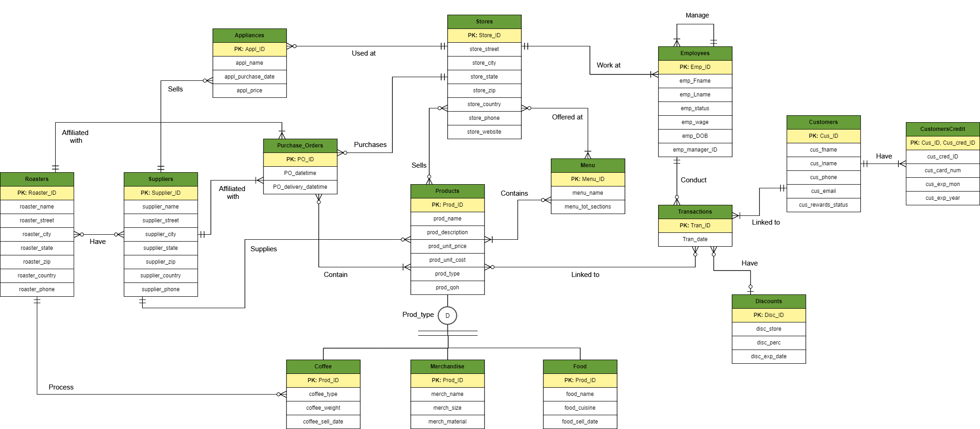
Summer Moon ERD
Notes:
Chris

Slide 5


Normalization
1NF - Repeating Groups, Composite Attributes, Multi-valued Attributes
Addresses, names were the most common
2NF - Partial Dependency, Composite PK
Transactions and Stores Tables
Not as common, preventative
3NF - Verify 2NF, Transitive / Functional Dependency
Transactions, Products, Employees
Not as common, preventative
Avoid data redundancies and data anomalies
Notes:
Chris - Transition to Jason

Slide 6

Data Collection/Creation
We used mock/dummy data for our database, but ensured it made sense for our business (real coffee drinks, merchandise typically sold at a coffee shop, etc.)
We found a free website that auto-generates dummy data specifically for database creation, useful for fields like customer info (email, address, phone numbers, etc.)
Notes:
Jason - transition to Andrew

Slide 7
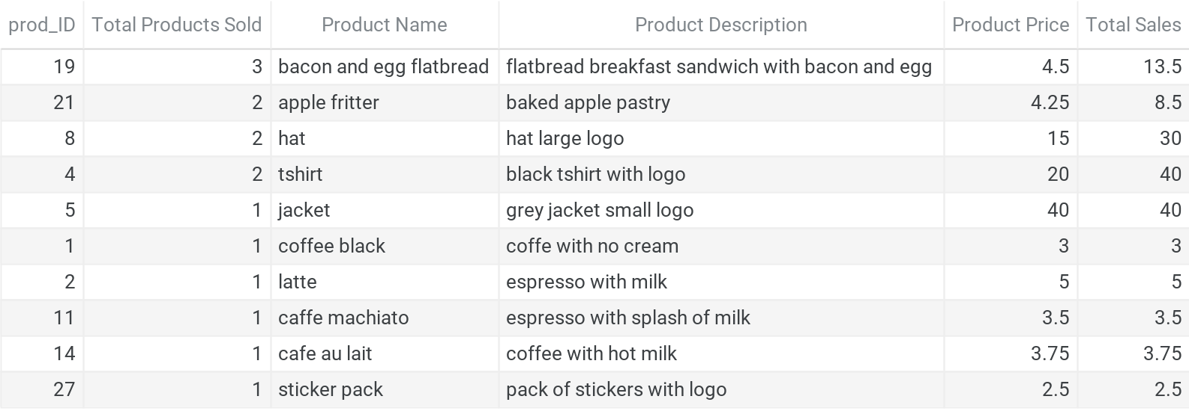
Report 1: Product sold the most
Executed a query that returned data on products sold in our stores and formatted column headers to make it easier to read
The bacon and egg flatbread was the most popular item sold in our stores
Our highest revenue items were T-shirts and jackets
Notes:
Andrew

Slide 8
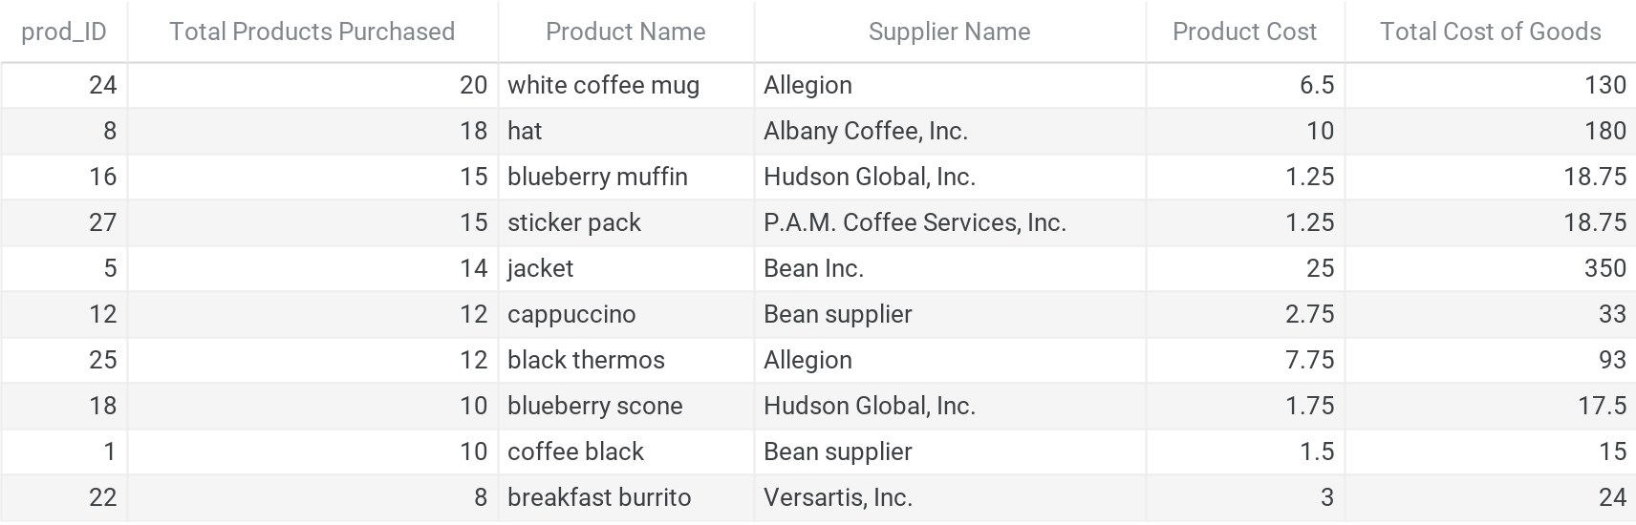
Report 2: Product ordered the most
Executed a query that returned data on products purchased from suppliers and formatted column headers
We purchased more white coffee mugs than any other product (20 items)
The product with the highest cost to us is the jacket ($350)
Notes:
Andrew - transition to Jason

Slide 9
Difficulty faced
ERD and Table Creation: Finding the balance of table creation vs table relationships. The table schema can get complicated fast when creating an ERD
Value Insertion: Making sure to insert data into the tables that did not have a FK first, otherwise you would get a key error
Distributing Work: Trying to split the work among group members, since many tasks and aspects of the database were related (reports, tables, etc.)
Notes:
Jason

Slide 10
Questions?

